Slide 1
TALLY
MADE BY AKKI

Slide 2
Introduction
Tally, crafted with Python, revolutionizes accounting simplicity. This versatile software comes in three editions: Family Tally, Business Tally, and Tally Terminal. Tally, your go-to accounting solution, simplifies financial management with ease. From seamless company creation to secure data handling, Tally ensures a streamlined experience. Enjoy password protection, encryption support, and smart cash management. Currently, the Terminal version is in development, catering specifically to business needs. Elevate your financial management with Tally.

Slide 3
What’s Stage 1
There are certain stages in this tally code that determine the progress and part of the code for help to understand in which part of code we have been talking about or help to know which part of code creating problem…..
1st Stage:- The first stage contains the initial screen of the Tally software. Here, we can create a company, open a company, and select a company. While creating a company, only valid data is accepted and stored for later recall. The stage includes password and encryption support, system info updating, and cash handling.

Slide 4
What’s in Stage 1
Company Management:
Create and open companies.
Manage multiple companies simultaneously.
Data Storage and Security:
Use JSON files for efficient data storage.
Avoid potential security risks with the eval function.
Implement password and encryption support for each company.
Data Validation:
Enforce data validation to prevent invalid entries.
Ensure data integrity.
Documentation and Updates:
Update documentation and information without code re-installation.
Automated checks for updates when companies are opened.
Financial Management:
Support cash updates with valid data, including current currency value.

Slide 5
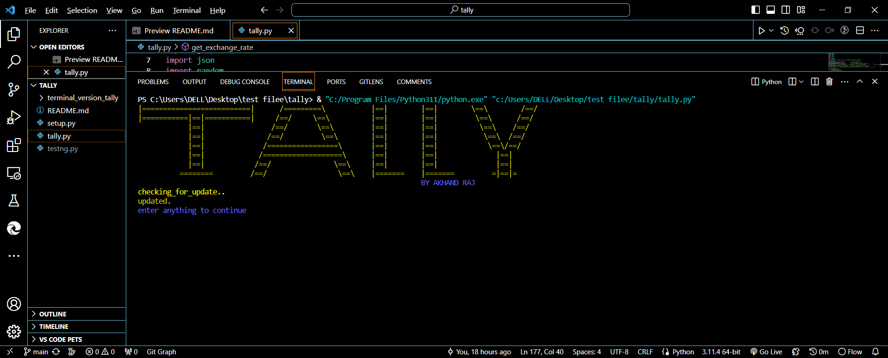
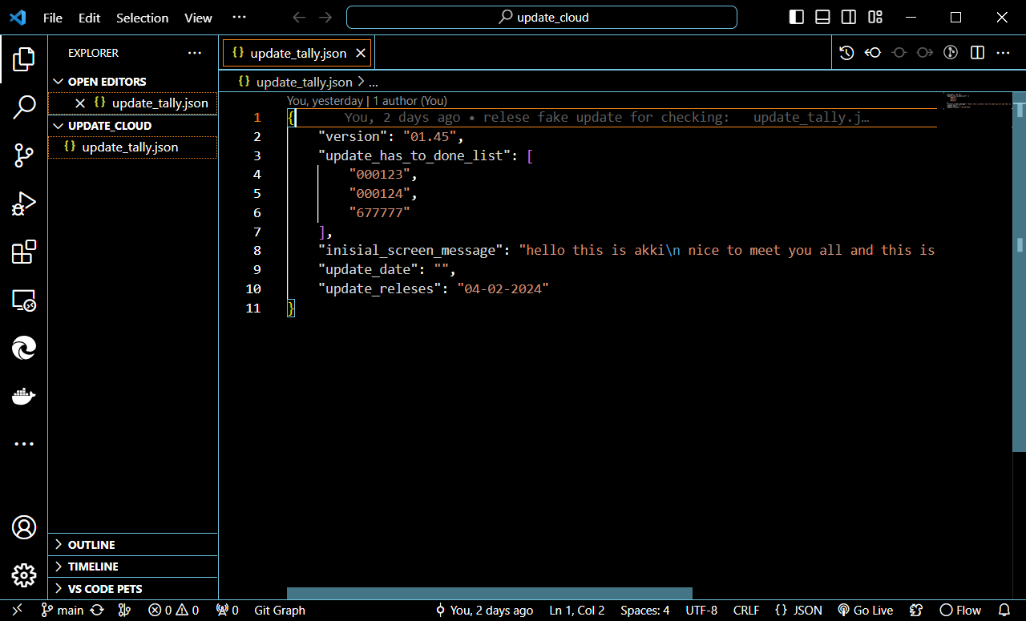
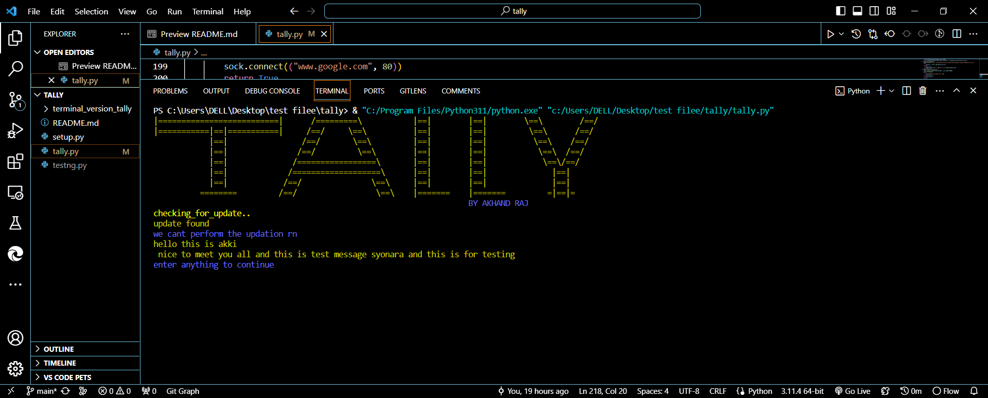
The first page is to check for updates
So the first page checks the update if there is update it’s update the filles define in it
So it’s basically for updation it’s download “JSON” file from git repository then check the update version if it’s similar it’s pass else it’s check what to update and download that specific file from git repository and update it this is how it’s update the software….
Updation:if there is no update screen looks like that
The JSON file to update by reading it it’s update the software
Updation:if there is update and show inisial message regarding update

Slide 6
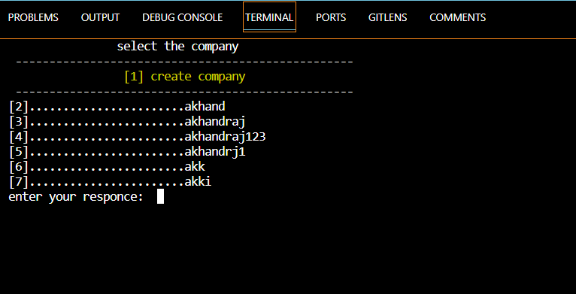
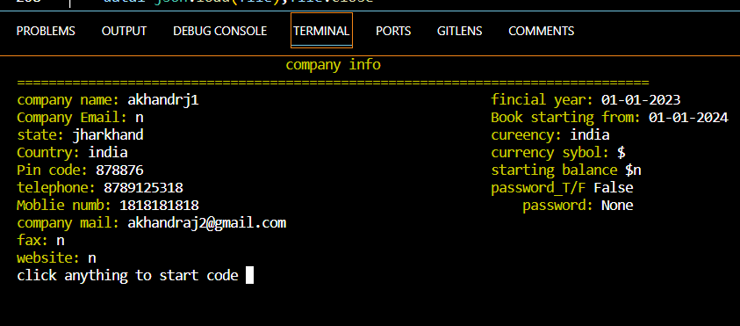
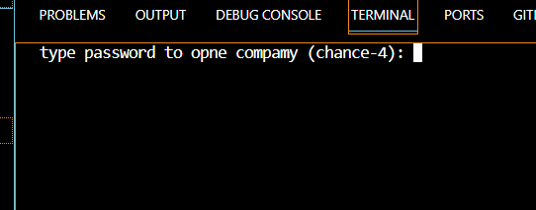
2nd page open or create company…
So the 2nd page is home where we can select company by inputting company serial number and for creating company we type [1] and for other opening company we start with [2] and the last where list end ……
If we select companie…..
If there is password it’s ask password if not 2nd page open
2. After that it’s open company info and there when we enter open G.O.T

Slide 7
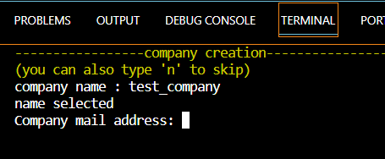
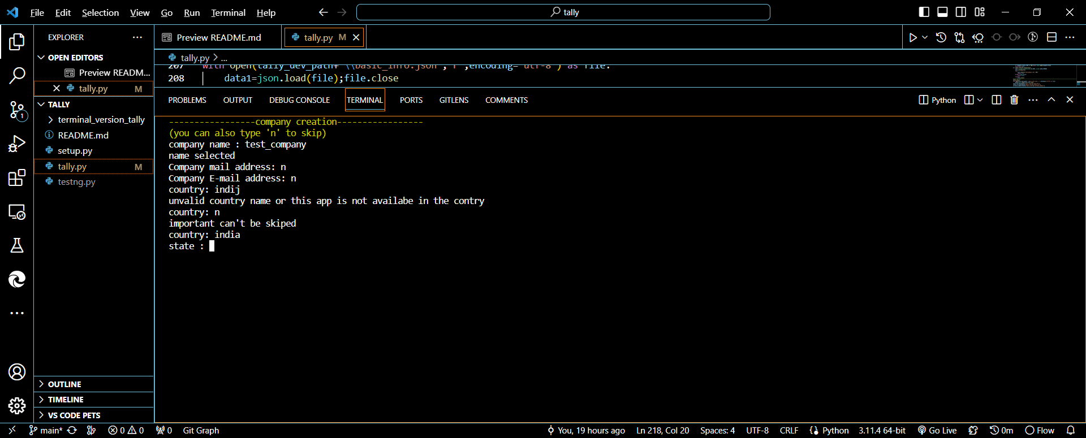
Create Company
So when we click on create company we get a form to like that a after filling it they show us all info and ask if it’s you want to if yes all info save and com created if not u get the form again
When u filing the form u can input ‘n’ in create company and that will bring u again to select company page
If you click ‘n’ in other section of form it’s will skip that part of info
If you enter ‘wrong info’ in form such as wrong number wrong mail wrong state and country name etc. it will show an error message and ask you to fill that detail again
After u finish with the form it’s ask for password while typing password u can’t see it and after that
It will ask for confirmation if you entered is correct or not if you type ‘y’ company created and if you type ‘n’ you get form again
All time of input an dresponse

Slide 8
Password and encryption
Substitution Cipher Encryption Technique
For encryptio prosess we using The Substitution Cipher Encryption Technique employed in this code involves the mapping of characters in a given string to specific codes during the encoding process. Similarly, during decoding, these codes are reversed to reconstruct the original string. In this implementation, a key is used to establish the mapping, ensuring a one-to-one correspondence between characters and their respective codes
Roles in tally software
For encryption password
For encryption critical data
Each company will have their unique key for better security
Provide security in a company
Features of S.U.E.T
Without mapping we can’t access the data and decode it
Can add multiple layer of encryption layers of protection in codes
Very simple to use
Yet it’s can’t provide high security but can protect with normal attack

Slide 9
How encryption works:-
Encoding (number_coding):
Each character in the input string is replaced with its mapped code, followed by '0' as a separator.
Characters not found in the key are appended with '0'.
Decoding (number_decoding):
The encoded string is split at '0' to identify each character.
If a character is '53', it is replaced with a random value from a specific range.
The remaining characters are mapped back to their original values using the key.
Key Generation:
The creation of a random key involves shuffling a list of two-digit numbers and concatenating them with '0'. This key serves as the foundation for both encoding and decoding processes.

Slide 10
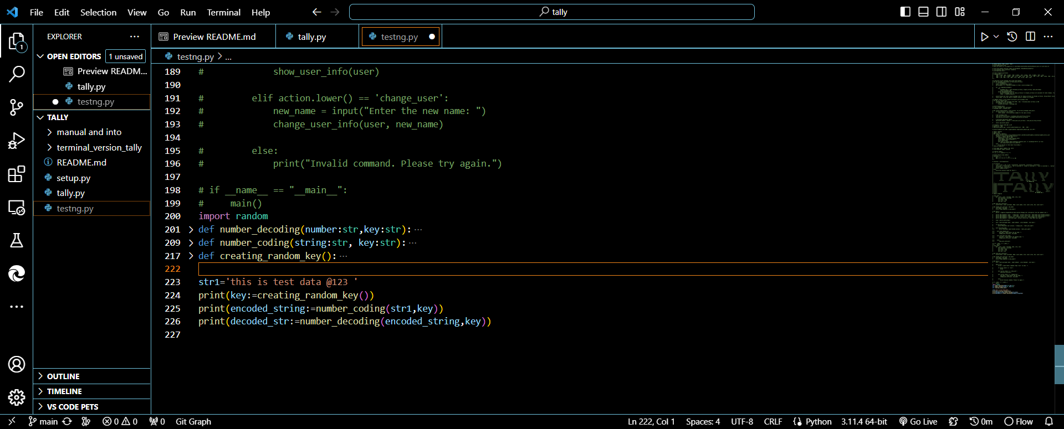
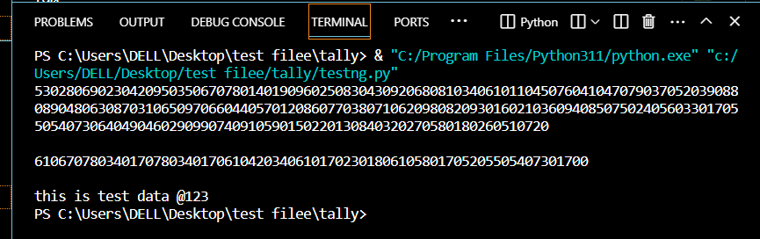
EXAMPLE
In 1st pic it’s first generating a unique key…
and then endecoded the string by using number coding and key encrypted the string
And then by using number decoding and key it’s decoded encrypted key
*Without using key we can’t perform encoding and decoding

Slide 11
Security Level Against Brute Force Attacks
The security level against serial brute force attacks depends on the size of the key space. In this case the lenthod key is 81 characters suggests a substantial key space To provide a rough estimate, you can consider the chance of randomly guessing the correct key as 1 in 81! This probability is extremely low, and it's practically impossible to obtain the correct key through brute force within a reasonable timeframe.
->chances of getting key by series brute force:-
Percentage≈ 81! / 1 ×100 = 0.000000000000000000000000000000001% of getting the key
->chances of getting key by random brute force:-
If we talking about random method to generate key for brute force then the length of 81 characters, and each character is randomly chosen, the total number of possible keys is 69⁸¹ (69 possibilities for each of the 81 characters).
Percentage ≈ 1 / 69⁸¹ × 100 = 0.0000000000…………………………….0001% a lot
-> attack coude help to get the key are:-
Cryptanalysis Techniques , Side-Channel Attacks , Social Engineering, session hijacking which all contain stealing the key instead of generating that key again it’s impossible to generate same key again so it’s depends on so to protect the generated key …..

Slide 12
Document Updation for Enhanced Tally Software Experience
The process of document updation in the provided code snippet serves the purpose of ensuring that the Tally software maintains access to the latest information, particularly regarding financial data like currency exchange rates. This periodic update mechanism enriches the software's functionality without necessitating a full code update.
Key Elements of the Update Process :---
Request for update_tally.json - at first it’s request for update_tally.json from github where it’s will gather info regarding update such as version , message to show and list of thing to update.
Check_the_update :-- then it’s check if the version of update_tally.json and the current version of software is equal or not if not it’s read the list of updation and update each list if not it’s passs
Updating_cash :- this is done every time the software open it’s update the cash or data that required latest version for better and effective use of tally such as exchange rate of currency
Status_tracking :- As part of the update process, the code maintains a record of status information, including the frequency of updates and the timestamp of the last update. This tracking mechanism aids in monitoring the software's performance and ensures timely maintenance of essential data.

